Slide 1
Operating system
Introduction

Slide 2
What is os ?
An operating system is a program that manages a computer’s hardware. It also provides a basis for application programs and acts as an intermediary between the computer user and the computer hardware.
Eg- Microsoft windows
macOS
Linux

Slide 3
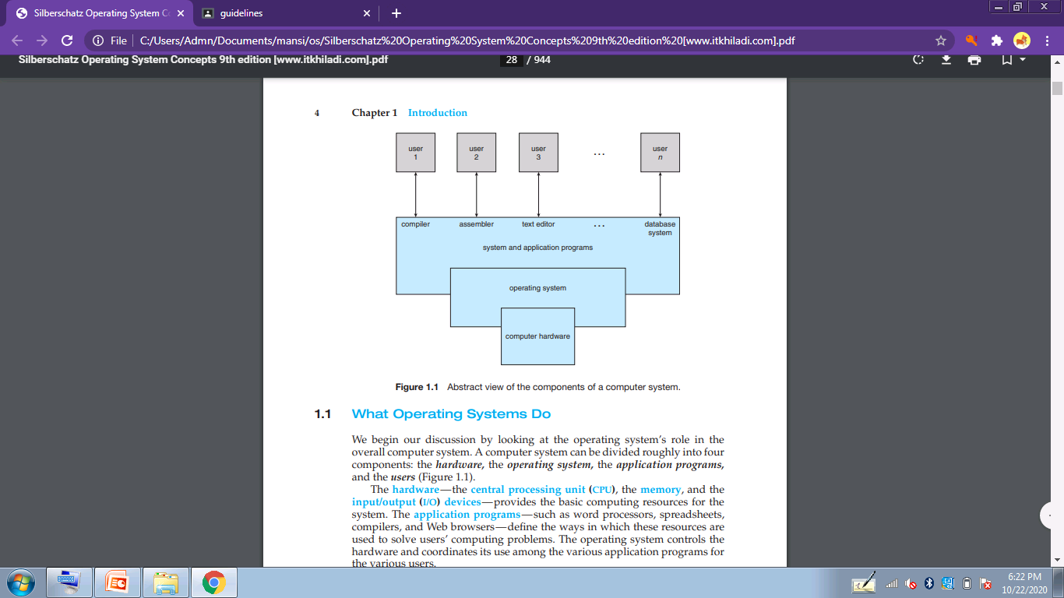

Slide 4
What os do ?
A computer system can be divided roughly into four components:
the hardware
the operating system
the application programs
the users

Slide 5
The operating system controls the hardware and coordinates its use among the various application programs for the various users.
The operating system controls the hardware and coordinates its use among the various application programs for the various users.
An operating system is similar to a government. Like a government, it performs no useful function by itself.
It simply provides an environment within which other programs can do useful work

Slide 6
User view
The user’s view of the computer varies according to the interface being used.
In pc and desktop :The goal is to maximize the work (or play) that the user is performing. In this case, the operating system is designed mostly for ease of use, with some attention paid to performance and none paid to resource utilization—how various hardware and software resources are shared.

Slide 7
In mainframe and mini computer : These users share resources and may exchange information. The operating system in such cases is designed to maximize resource utilization— to assure that all available CPU time, memory, and I/O are used efficiently and that no individual user takes more than fair share.
In work-station and server: These users have dedicated resources at their disposal, but they also share resources such as networking and servers, including file, compute, and print servers. Therefore, their operating system is designed to compromise between individual usability and resource utilization.

Slide 8
In smart phones :The user interface for mobile computers generally features a touch screen, where the user interacts with the system by pressing and swiping fingers across the screen rather than using a physical keyboard and mouse
Some computers have little or no user view. For example, embedded computers in home devices and automobiles may have numeric keypads and may turn indicator lights on or off to show status, but they and their operating systems are designed primarily to run without user intervention

Slide 9
System view
The operating system is the program most intimately involved with the hardware. an operating system work as a resource allocator.
A computer system has many resources that may be required to solve a problem: CPU time, memory space, file-storage space, I/O devices, and so on. The operating system acts as the manager of these resources.

Slide 10
Facing numerous and possibly conflicting requests for resources, the operating system must decide how to allocate them to specific programs and users so that it can operate the computer system efficiently and fairly
An os is a control program. A control program manages the execution of user programs to prevent errors and improper use of the computer. It is especially concerned with the operation and control of I/O devices.

Slide 11
Defining os
the operating system is the one program running at all times on the computer—usually called the kernel. (Along with the kernel, there are two other types of programs: system programs, which are associated with the operating system but are not necessarily part of the kernel, and application programs, which include all programs not associated with the operation of the system.)

Slide 12
Mobile os
Mobile operating systems often include not only a core kernel but also middleware—a set of software frameworks that provide additional services to application developers. For example, each of the two most prominent mobile operating systems—Apple’s iOS and Google’s Android—features a core kernel along with middleware that supports databases, multimedia, and graphics

